Slide 1
MySQL & PHP
Simple use & application

Slide 2
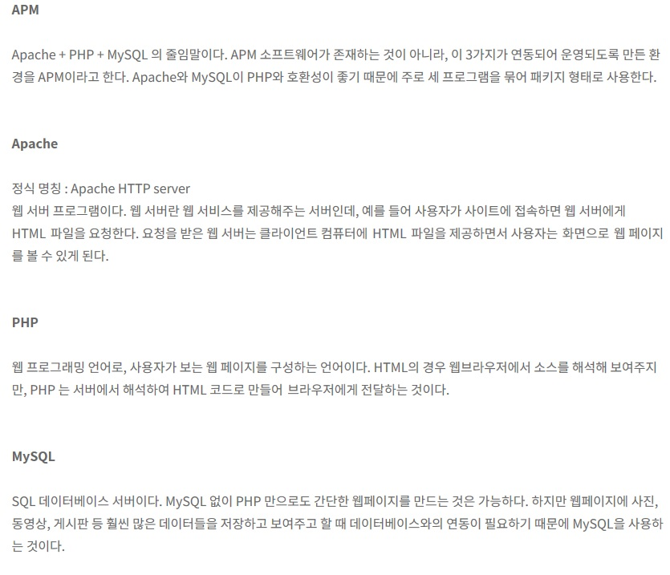
What is APM? <http://to-paz.tistory.com/8>

Slide 3
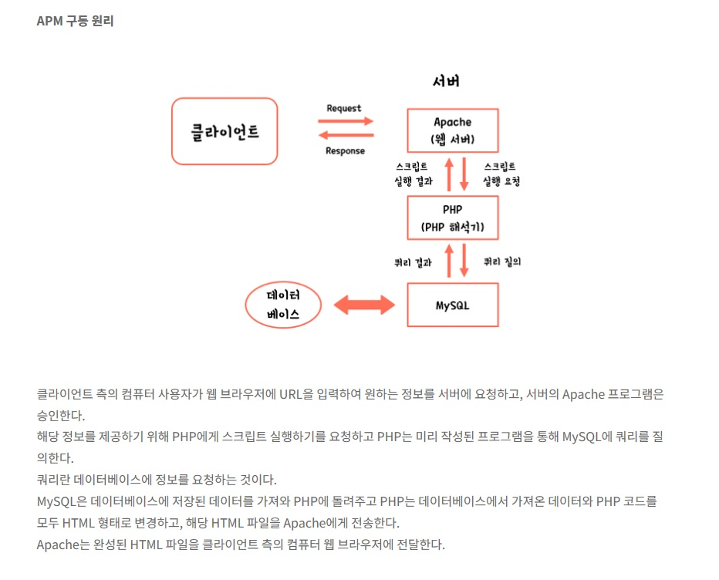

Slide 4
Basic of MySql <www.w3school.com>
- Select
- Create table
- Where & And, Or, Not
- Order By
- Insert Into
- Delete
- Joins
- & etc…

Slide 5
Basic of PHP <www.w3school.com>
- Is very simple…. To use….
- <? Php
$test = 1;
If ($test)
{
Echo $test;
}
.
.
?>

Slide 6
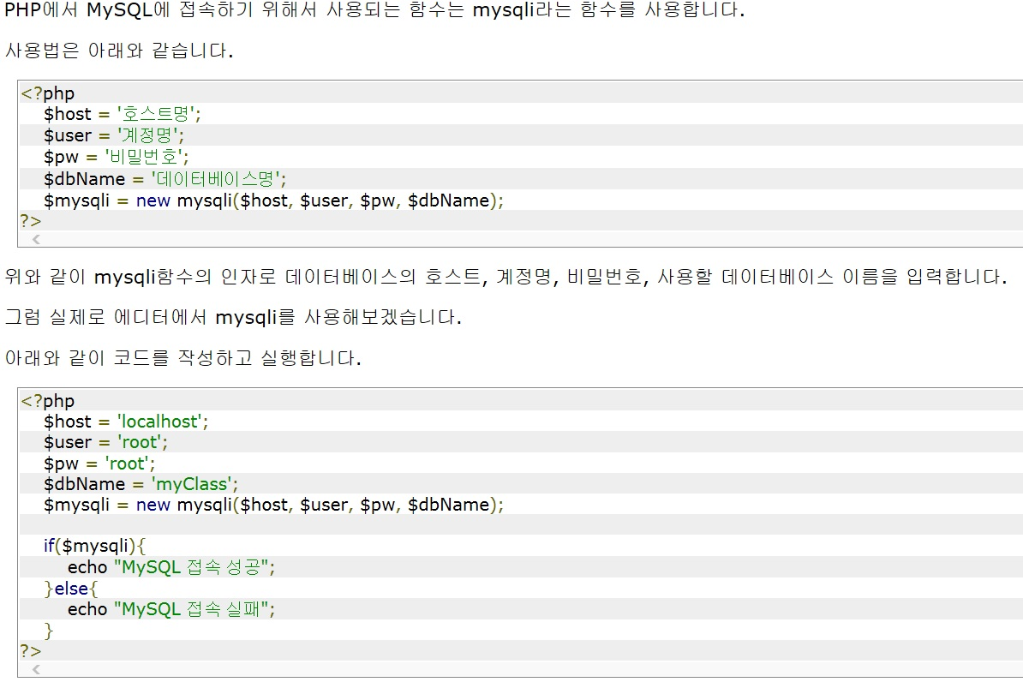
MySQL & php
http://www.everdevel.com/PHP/linkage-php-mysql.php
http://bitsoul.tistory.com/64
http://jaewon37.tistory.com/6

Slide 7
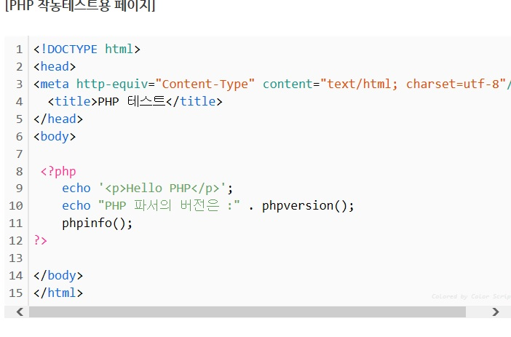
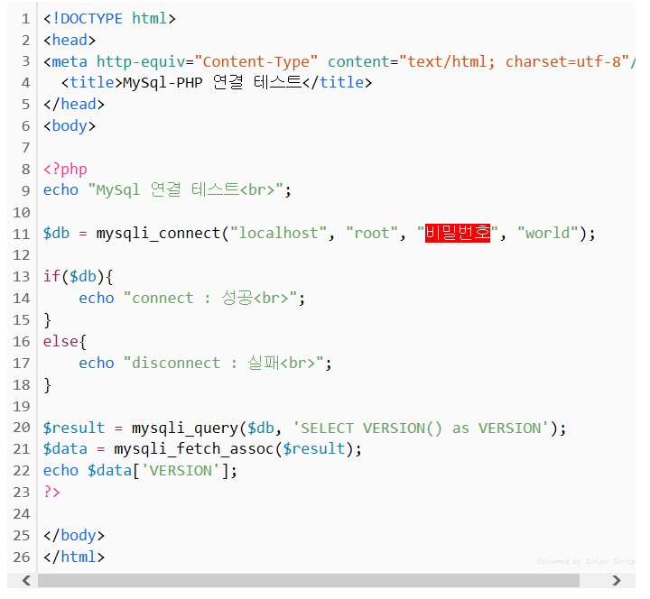

Slide 8
